Slide 1

Capstone project –The battle of Neighbourhoods selecting the best location to open a sushi restaurant in Central Toronto, Toronto

Slide 2
IntroDuction/Business problem
The city of Toronto is famous for its delicious cuisine. It’s food culture includes an array of international cuisines influenced by city’s immigrant history
Sushi restaurants have become so popular in the Canada now it seems there is one on every corner. not only in major cities but also in smaller cities. Starting a sushi restaurant can be a great business opportunity , but you need to distinguish yourself from others to enjoy a resounding success

Slide 3
Business Problem
My clients wants to open his business in Central Toronto area, so I focus on that borough during my analysis. We define potential neighborhood based on the number of sushi bars which are operating right in each neighborhood. Central Toronto has full potential but also is a very challenging district to open a business because of high competition. New sushi bar should be open in an area that that has insufficient sushi bars int his way it can attract more customers. Therefore, this analysis is necessary to ensure that we have enough customers and that we are not so close to other sushi places.

Slide 4
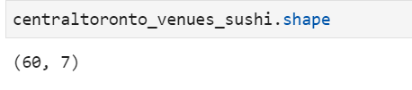
Data Selection
To identify the characteristics of our competitor’s venues in Central Toronto , we would first need to find out the number of sushi bars in Central Toronto and their location.
We then used the foursquare api to find their geographic coordinates based on their postal code addresses.
In Central, Toronto there are 60 sushi bars that are currently operating

Slide 5
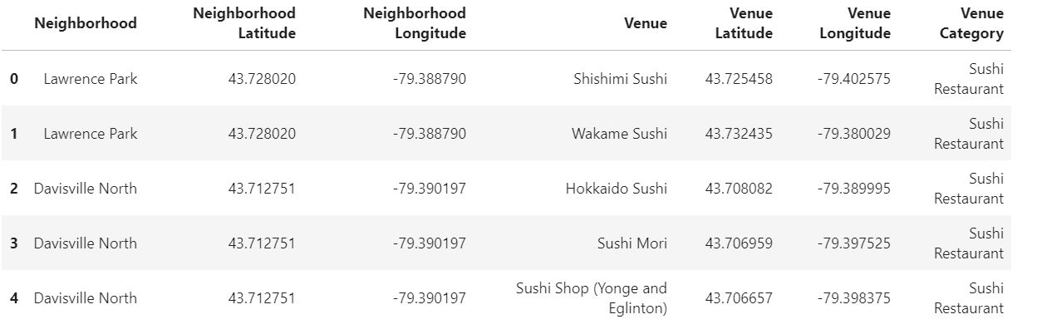
Data Selection
Next we also use foursquare api to find their geographic coordinates of the 5 location shortlisted for our sushi bar

Slide 6
Methodology
Addresses are converted into their equivalent latitude and longitude values.
Foursquare API is used to explore neighbourhoods in Central Toronto
After that , explore function to get sushi restaurant categories in each neighbourhood

Slide 7
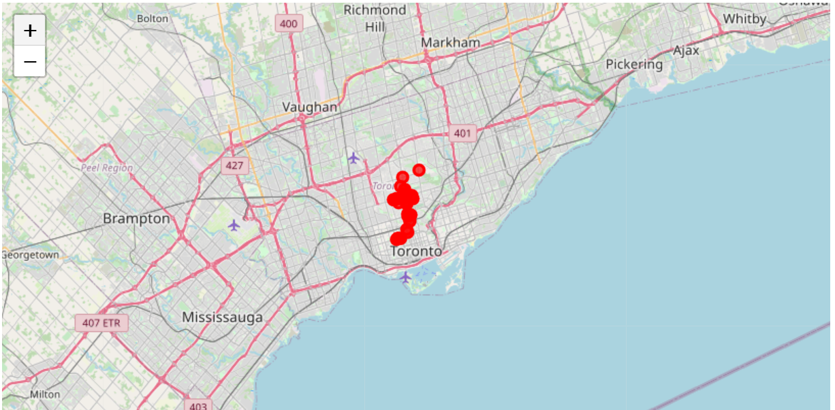
Methodology
Sushi bars in Central Toronto

Slide 8
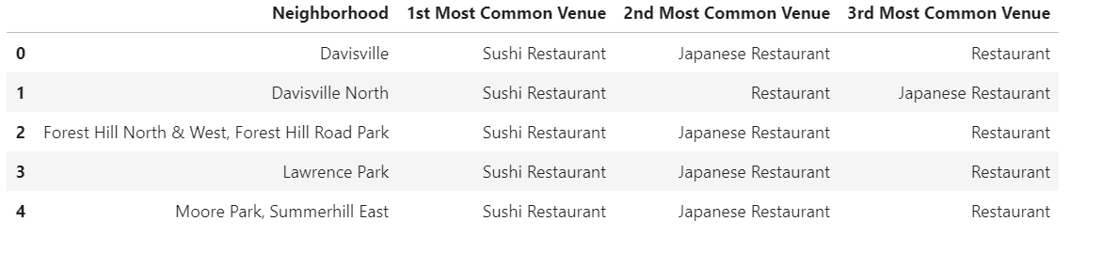
Methodology
Then using this feature to group the neighborhoods into cluster K-means clustering algorithm will be used to complete this task. And also, the folium library to visualize the neighborhoods in Central Toronto and its emerging clusters.

Slide 9

Results
Using K-mean to clustering data area with less number of sushi bars
Cluster 0

Slide 10
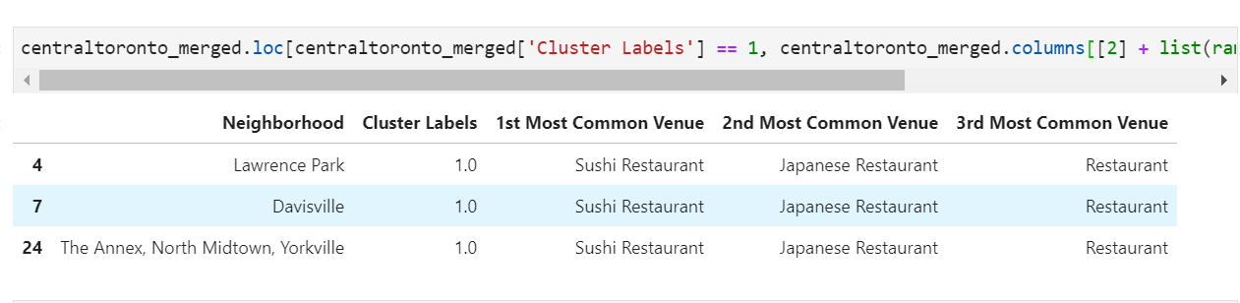
Result
Cluster 1

Slide 11
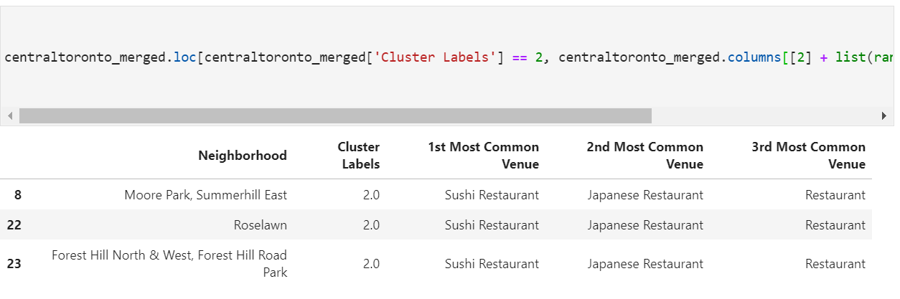
Results
Cluster 2

Slide 12
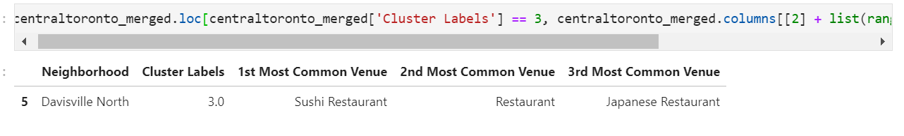
Results
Cluster 3

Slide 13
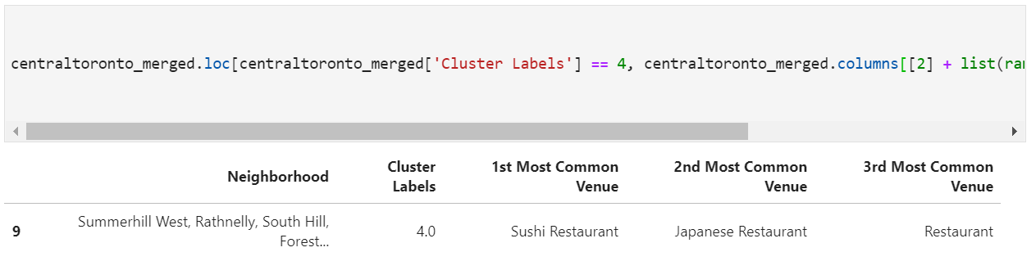
Results
Cluster 4

Slide 14
Results
Based on dataframe analysis above cluster 3 Davisville North and and cluster 4 Summerhill west areas are the best places to open a new sushi bar business.

Slide 15
Discussion
This analysis was performed on limited data. But if a decent amount of data is available there is a scope to come up with better results
This is high competition in other areas so it is very risky to open business int hose areas.
One can do more detailed analysis by adding other factors such as transportation , demographics and number of inhabitants.

